Slide 1
Diagnosing Patient #4
Lucas McDuff and Meghan Mumpower

Slide 2
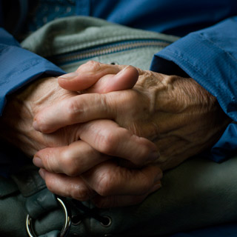
What We Looked For
55 years old
Movement is very slow
Poor balance
Needs support to stand straight
Shaking Hands
Bad, small handwriting

Slide 3
What do they have?
Based on slow motor functions and shaking of the limbs, the patient was determined to have Parkinson’s disease.
Parkinson’s is a disease that affects the messages for smooth movement from the Substantia Nigra in the brain. Because of this, it causes severe impairment of movement.

Slide 4
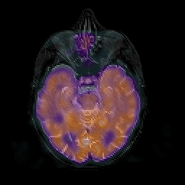
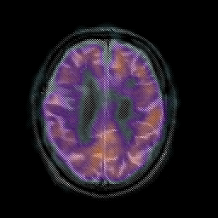
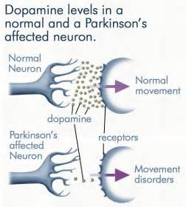
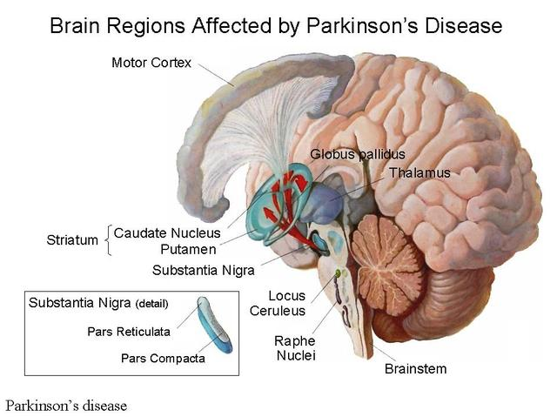
How communication is stunted
Parkinson’s disease is caused by a deterioration of the neurons in the Substantia Nigra. These cells use Dopamine to communicate with the Corpus Striatum. This communication between the two areas results in a steady stable flow of movement throughout the body. Without it, tremors and an inability to move is caused.
This is a brain that is not diseased.
This is a brain that’s motor neurons are degenerating or are not communicating.

Slide 5
What does this mean for John?
Stages and Progression
Treatment
As the disease progresses, he will have new and worse side affects occuring. This patient is between stage one and two.
Stage 1: Tremors, slower movement, poor posture, unbalanced, family notices.
Stage 2: Affects both sides of the body, problems walking, tasks are much more difficult.
Stage 3: Can’t walk straight or stand, slowing of movements.
Stage 4: Hardly mobile, cannot live by themselves, brandykinesia.
Stage 5: Can’t walk and has to be taken care of every moment.
Minor medicines can be used to treat side affects of the disease before taking Sinemet.
Sinemet is the most common drug used to treat Parkinson’s. Unfortunately, it has many side affects that can occur, many which can be severe to other areas of a patient’s health. For it to function at the best capacity, a low-protein diet is recommended so diet can also be affected by Parkinson’s.
Exercise is another helpful aspect of trying to help the side affects of having Parkinson’s. It can help strengthen the muscles and give them more stability.

Slide 6
Who can help?
A neurologist is a doctor who focuses on the study of nerves. Based on this, they’re going to have a deep understanding of Parkinson’s and your treatment options.

Slide 7
Other options
In the final stages of your disease, Parkinson’s patients are often cared for by a family member or nurse. A nurse will have the necessary medical skills and knowledge needed to care for their patient.
Along with care, there is also support. There are various Parkinson’s awareness groups that are willing to help emotionally and financially for Parkinson’s patients.

