Slide 1
#TooFly
Meghan Mumpower, Lucas McDuff, and Zach Biggers

Slide 2
What Can We Do for You?
We are a company that will is attempting to make flying safer for any passenger traveling with your airline. It will not only monitor people going onto your planes, but it also monitors people garnering tickets. This can oftentimes increase the city safety as well by limiting criminal travel and activity.
We will be using different methods of biometrics such as photo identification and other photographic methods to identify passengers going through security.

Slide 3
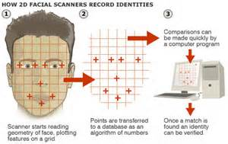
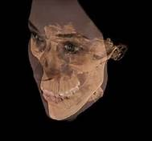
The Plan
How would this be done?
What does it look for?
We would like to have your customers take a picture while taking their ticket. There would be no specific background and only one person in the picture. There picture would be scanned into the system and stored until their flight. Upon arrival at your airport, in security, a facial scan would be done of the person and there would need to be seven different facial similarities between the photo and yourself. Then again, when boarding the plane, the same security procedure would be done. In addition, the person running the computer would also have to confirm the identification.
When the computer is comparing your face with its recorded picture, it will look for various facial similarities. These could include: eye color, eye shape, cheek bone prominence, hair color, nose shape, forehead width, lip shape and color, skin tone, ridges, moles, and even prominent freckles. In order for the person to be cleared by the computer, seven facial traits have to be found in common with your picture and the scan.

Slide 4
What could go wrong?
Although computers are usually accurate, we understand that they could malfunction. What would happen if the system shut down, in this case, there would be a back up computer. Along with this, the picture submitted would be printed on the individuals ticket and a person could verify that it is them.
Another problem, what if the computer did not recognize them? Due to this, there would be a system. A trained official would be able to put in an override code. The only people that would have access to this code, would be the president of the airport, a trained official, and the CEO of the company. To ensure maximum security, the code will change every two days to reduce the threat of security breaches. Because of this, “beating the system” would be very difficult and near impossible.

Slide 5
IT WORKED!
At the Atlanta International Airport, they wanted to make sure that people leaving their airport would be safer. They had a functioning security system, but not one that showed the people boarding this plane. Not only did this begin to help airport safety and organization, but it had another positive affect. Many criminals were still traveling through the airports right under the police’s nose. With this installment, the criminal had to be identified by using his name and the picture now matched the federal database. This not only increased the airport security, but the city safety.

